Slide 1

Desicion Trees, ROC/AUC analysis and Clustering Methods: A Data Mining Overview
CSE 435: Data Mining
Section: 221 D5
KHONDOKAR SAIM - 221902353

Slide 2
TABLE OF CONTENTS
01
Set 01: Decision Tree
02
Set 02: Concepts on Tree Splitting and Tree Pruning
03
Set 03: ROC Curve, AUC
04
Set 04: Cluster Analysis (K-Medoids)
05
Set 05: Density Based Clustering (DBSCAN)
BUILDING A PREDICTION PLATFORM

Slide 3
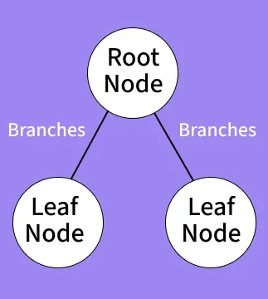
Set 01: Decision Tree
What is a Decision Tree?
A Decision Tree is a visual model that helps us make decisions by mapping out different choices and their possible outcomes.
Tree-like Structure: Starts with a main question (root node) and branches into possibilities
Supervised Learning: Used for classification and regression tasks
Interpretable: Easy to understand the decision-making process
Non-linear: Captures complex relationships in data
Key Components
Root Node
Starting point representing the whole dataset
Internal Nodes
Points where decisions are made based on features
Leaf Nodes
End points where final decisions or predictions are made

Slide 4
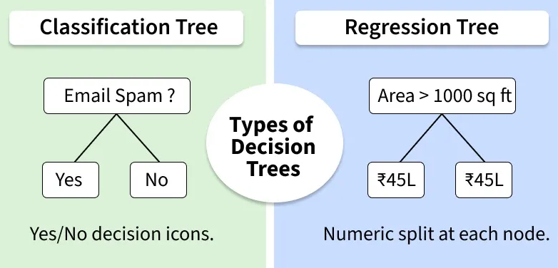
Set 01: Decision Tree
Types of Decision Trees
Classification Trees
Purpose: Predict categorical outcomes
Example: Spam detection (spam/not spam), Disease diagnosis (diabetic/non-diabetic)
Regression Trees
Purpose: Predict continuous numerical outcomes
Example: House price prediction, Stock price forecasting

Slide 5
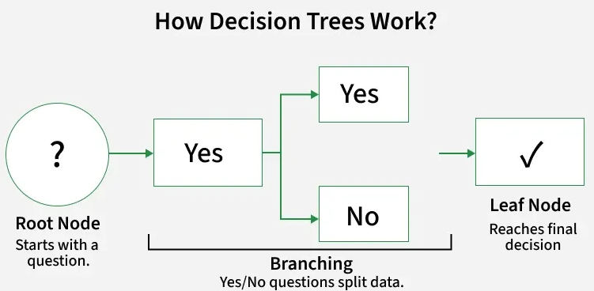
Set 01: Decision Tree
How Decision Trees Work?
Start with Root Node: Begin with a main question about the dataset
Ask Yes/No Questions: Tree asks series of binary questions to split data
Branch Based on Answers: Different paths for yes and no responses
Continue Splitting: Recursively divide data into subsets
Reach Leaf Nodes: Final predictions when no more useful questions remain

Slide 6
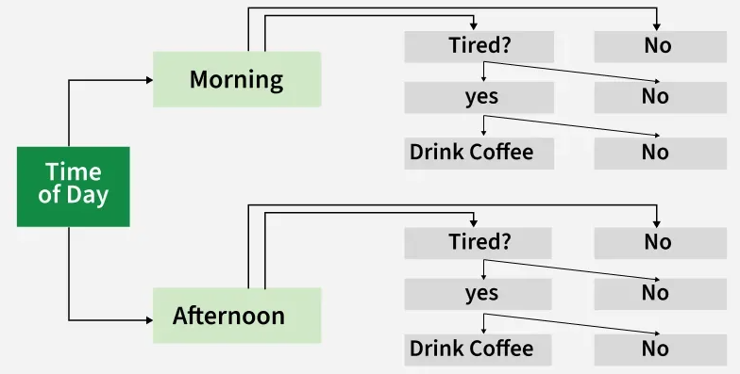
Set 01: Decision Tree
Real-World Example: Coffee Decision
Question: Should you drink coffee?
First Check: What time of day?
Morning: Ask "Tired?" → Yes = Coffee ✓ | No = No coffee ✗
Afternoon: Ask "Tired?" → Yes = Coffee ✓ | No = No coffee ✗

Slide 7
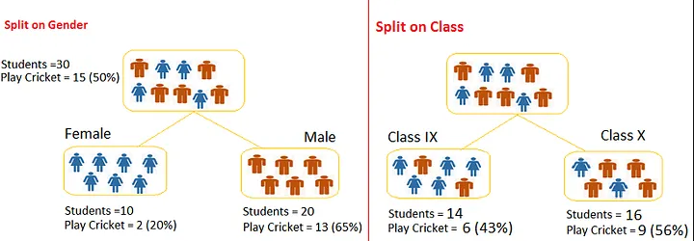
Set 02: concepts on Tree Splitting & Tree Pruning in Decision Tree
What is Tree Splitting?
The process of partitioning a dataset into smaller and smaller subsets based on feature values.
Key Concept: At each node, the algorithm selects a feature and threshold that best separates the data into homogeneous subsets. This continues recursively until stopping criteria are met.
Splits occur on a particular variable/feature
Goal is to maximize homogeneity within each subset
Process continues recursively down the tree

Slide 8
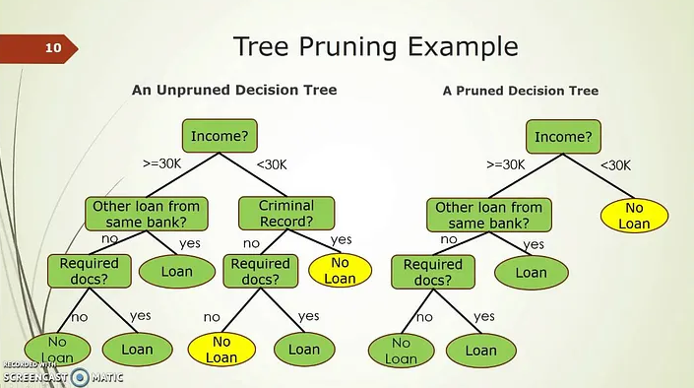
Set 02: concepts on Tree Splitting & Tree Pruning in Decision Tree
What is Tree Pruning?
Pruning is the process of shortening branches by converting some branch nodes into leaf nodes and removing leaf nodes under the original branch.
Key Goal: Reduce tree complexity while maintaining or improving predictive performance on new, unseen data.
Simplifies the tree by removing unnecessary branches
Reduces overfitting to training data
Improves generalization on new data

Slide 9
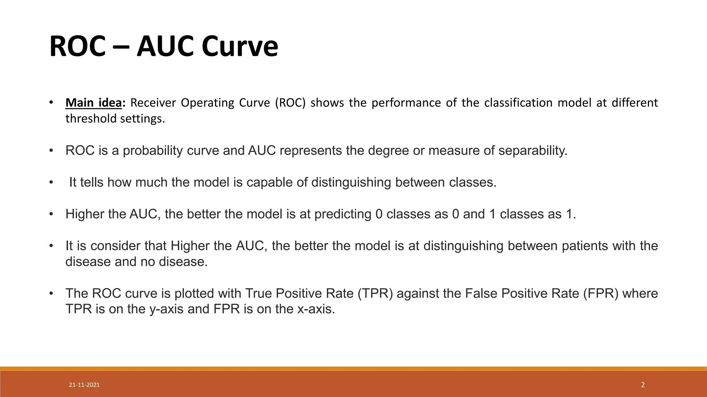
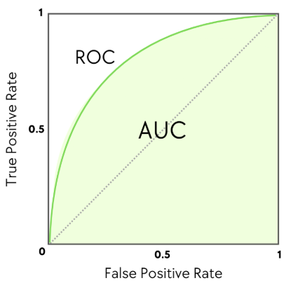
Set 03: ROC curve, AUC

Slide 10
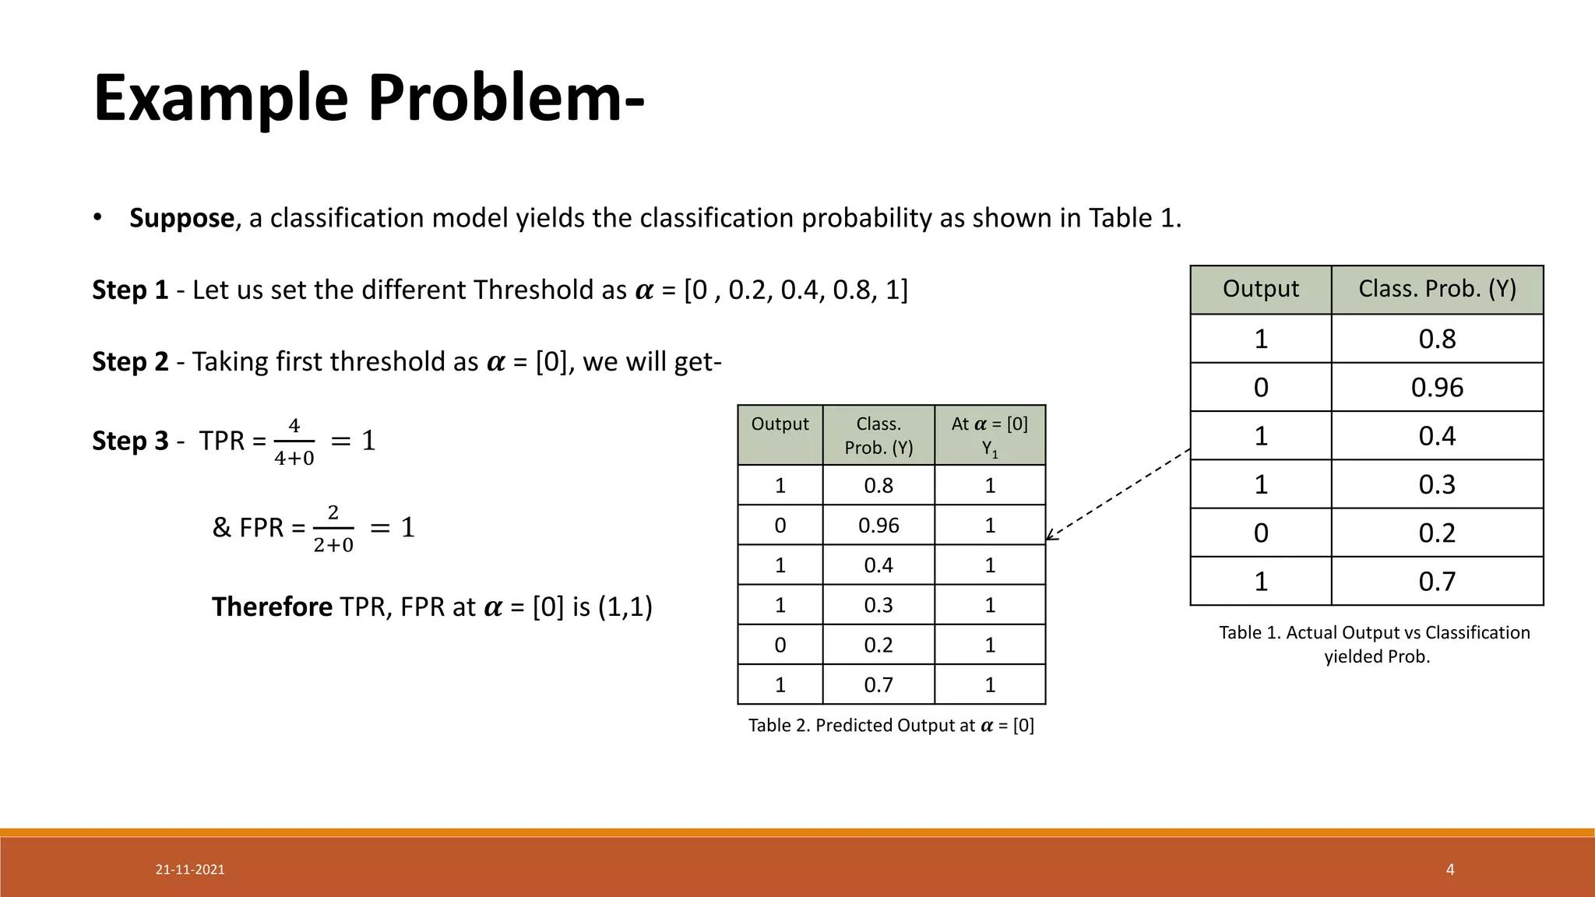
Set 03: ROC curve, AUC

Slide 11
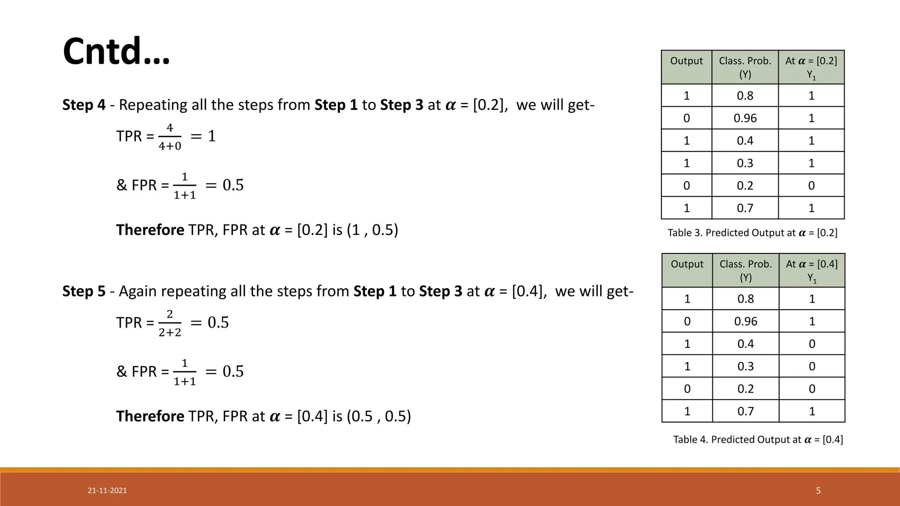
Set 03: ROC curve, AUC

Slide 12
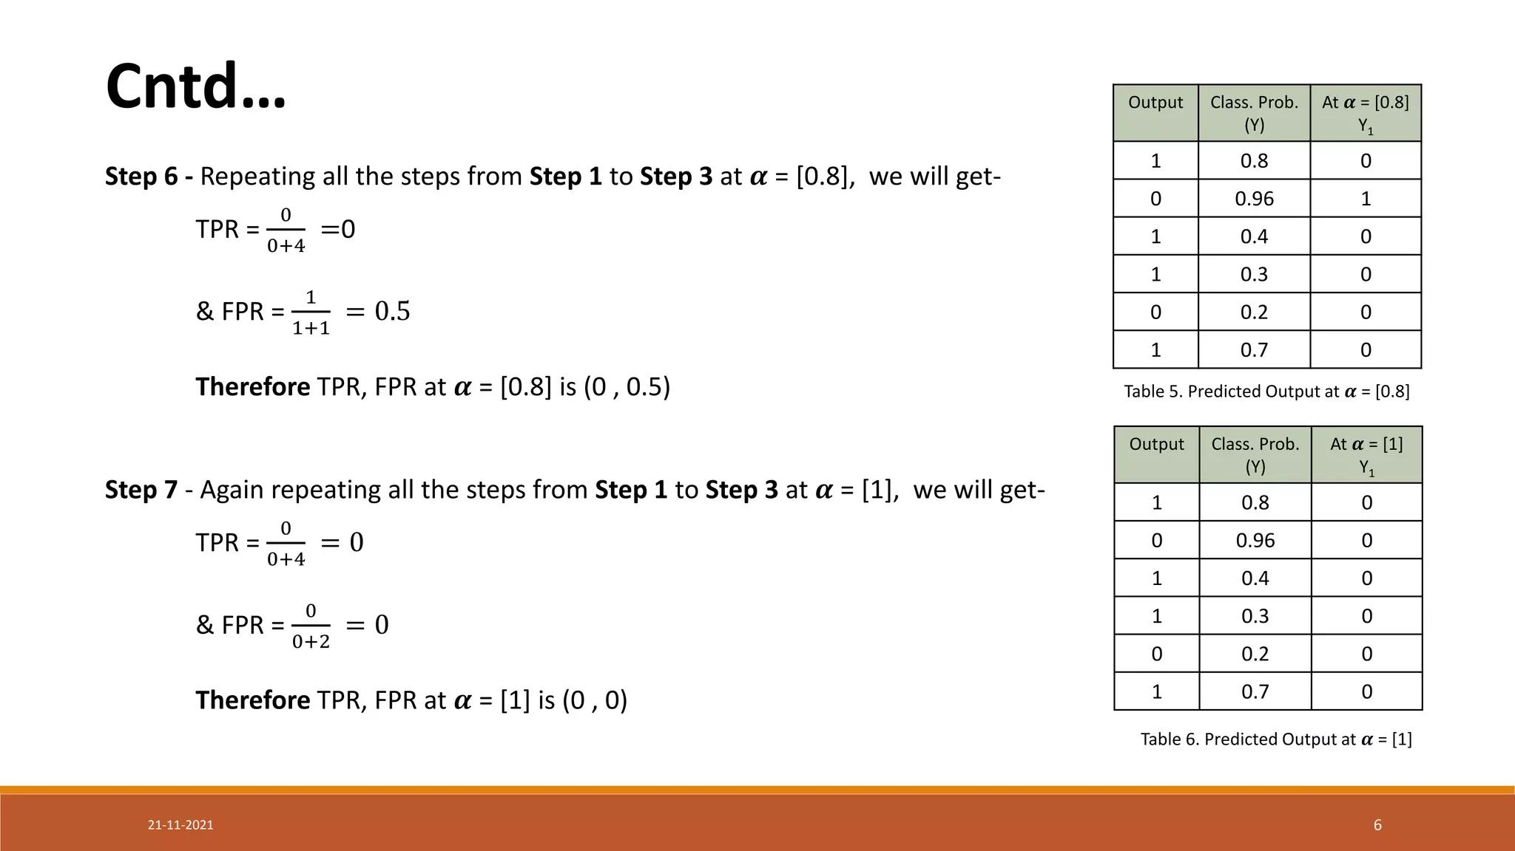
Set 03: ROC curve, AUC

Slide 13
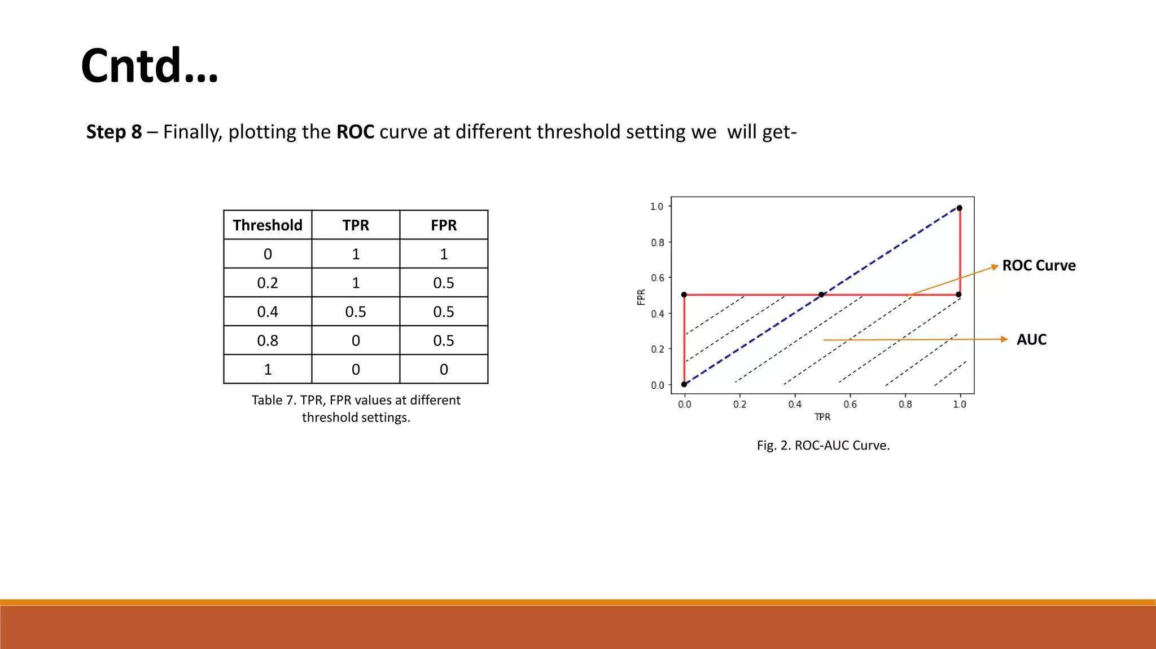
Set 03: ROC curve, AUC

Slide 14
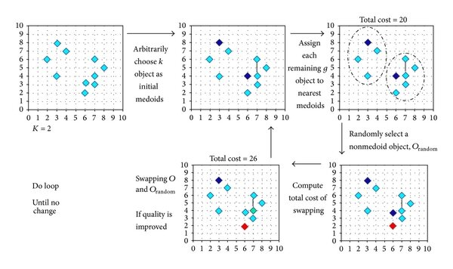
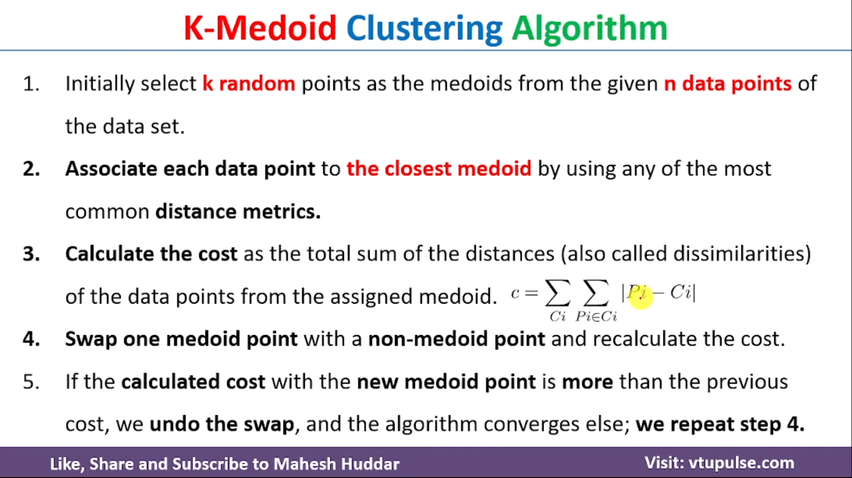
Set 04: Cluster Analysis (K-Medoids)

Slide 15
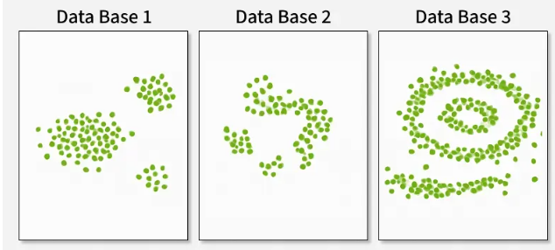
Set 05: Density Based Clustering (DBSCAN)
What is DBSCAN?
DBSCAN is a density-based clustering algorithm that groups data points that are closely packed together and marks outliers as noise based on their density in the feature space.
Key Advantage: Unlike K-Means or hierarchical clustering, DBSCAN does NOT assume clusters are compact and spherical—it can find arbitrary-shaped clusters and handle noise effectively.
Arbitrary-Shaped Clusters: Clusters can take any shape, not just circular
Noise Handling: Effectively identifies and isolates outliers
No Pre-defined K: Automatically determines number of clusters
Key Parameters: eps and MinPts
eps (Epsilon)
Radius of neighborhood around each point
If eps too small → most points = noise
If eps too large → clusters merge together
MinPts (Minimum Points)
Min points within eps radius to form dense region
Rule of thumb: MinPts ≥ D+1 (D=dimensions)
Minimum: MinPts = 3 recommended

Slide 16
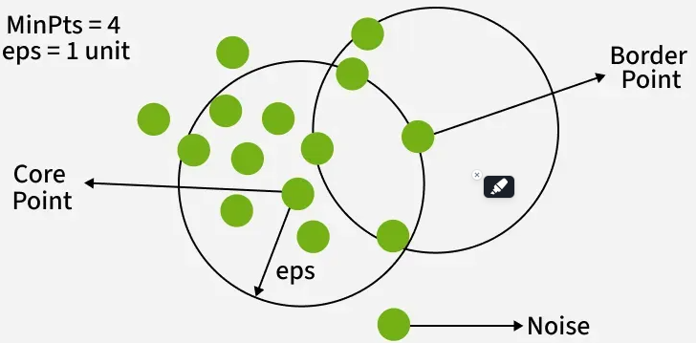
Set 05: Density Based Clustering (DBSCAN)
How Does DBSCAN Work?
DBSCAN works by categorizing data points into three types:
Core points which have a sufficient number of neighbors within a specified radius (eplison)
Border points which are near core points but lack enough neighbors to be core points themselves
Noise points which do not belong to any cluster.
By iteratively expanding clusters from core points and connecting density-reachable points, DBSCAN forms clusters without relying on rigid assumptions about their shape or size.

Slide 17


